Slide 1
Year 3 - Summer 2
Autumn 1 (revision of arithmetic skills from year 2)
Addition & subtraction / fractions/ multiplication & division
Autumn 2 (revision of arithmetic skills up to and including autumn 1, year 3)
Numbers up to 1000 / addition & subtraction / fractions
Spring 1 (revision of arithmetic skills up to and including autumn 2, year 3)
Numbers up to 1000 / addition & subtraction / multiplication & division
Spring 2 ( revision of arithmetic skills up to and including spring 1, year 3)
Addition & subtraction / multiplication & division / mixed
Summer 1 (revision of arithmetic skills up to and including spring 1, year 3)
Fractions / multiplication & division/ mixed
Summer 2 (mixed arithmetic from year 3)
Multiplication & Division/ mixed / mixed

Slide 2
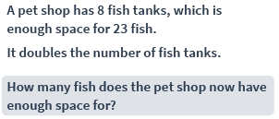
Summer 2 – Yellow
Week 1
Session 1 – Multiplication & Division
Option A
Option B
1 | 3 x 3 =
2 | x 5 = 55
3 | 20 ÷ 4 =
4 | 7 x 2 =
5 | 33 x 6 =
1 | 24 ÷ 8 =
2 | 81 x 2 =
3 | 36 ÷ = 3
4 | 71 x 8 =
5 | ÷ 2 = 15

Slide 3
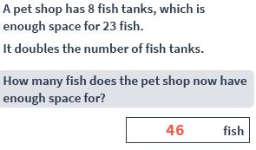
1 | 9
2 | 11
3 | 5
4 | 14
5 | 198
1 | 3
2 | 162
3 | 12
4 | 568
5 | 30

Slide 4
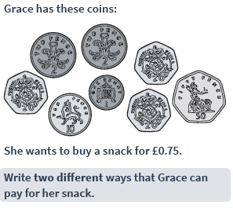
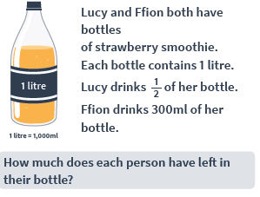
Summer 2 - Yellow
Week 1
Session 2 – Mixed questions
Option A
Option B
1 | 200 + 100 + 100 =
2 | 455 + 1 =
3 | 513 + 100 =
4 | 6901 – 1 =
5 | 146 – 10 =
1 | - 36 = 36
2 | 604 + 199 =
3 | 371 – 34 =
4 | $$\frac{1}{5} of 40=$$
5 | 835 – 652 =

Slide 5
1 | 400
2 | 456
3 | 613
4 | 6900
5 | 136
1 | 72
2 | 803
3 | 337
4 | 8
5 | 183

Slide 6
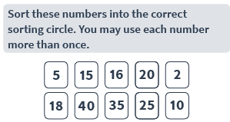
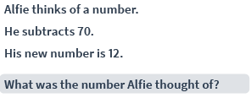
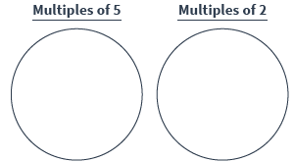
Summer 2 – Yellow
Week 1
Session 3 – Mixed questions
Option A
Option B
1 | 165 + = 275
2 | $$\frac{3}{7}+\frac{3}{7}=$$
3 | 256 + 36 =
4 | 700 + 100 + 100 =
5 | 309 + 1 =
1 | $$\frac{3}{4} of 4 0=$$
2
3 | 473 – 56 =
4 | - 45 = 35
5 | $$\frac{1}{8}of 24=$$

Slide 7
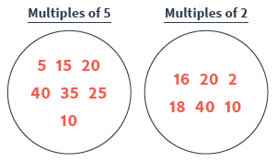
1 | 110
2 | $$\frac{6}{7}$$
3 | 292
4 | 900
5 | 310
1 | 30
2 | 952
3 | 417
4 | 80
5 | 3

Slide 8
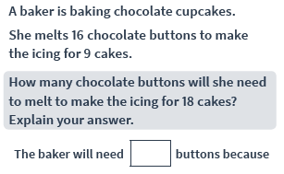
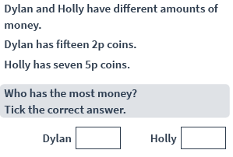
Summer 2 - Yellow
Week 2
Session 1 – Multiplication & Division
Option A
Option B
1 | x 8 = 16
2 | 3 ÷ = 3
3 | 90 ÷ 2 =
4 | 4 x 8 =
5 | 88 x 5 =
1 | 70 ÷ = 35
2 | 63 x 3 =
3 | = 7 x 8
4 | 93 ÷ 3 =
5 | 96 ÷ 8 =
÷

Slide 9
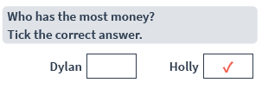
1 | 2
2 | 1
3 | 45
4 | 32
5 | 440
1 | 2
2 | 189
3 | 56
4 | 31
5 | 12

Slide 10
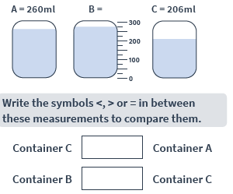
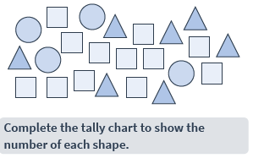
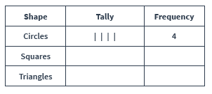
Summer 2 - Yellow
Week 2
Session 2 – Mixed questions
Option A
Option B
1 | 796 + 100 =
2 | 710 – 1 =
3 | 987 – 10 =
4 | 473 – 24 =
5 | $$\frac{1}{5}+\frac{2}{5}=$$
1 | 346 + = 450
2
3 | $$\frac{3}{4}of 20=$$
4 | 828 – 377 =
5 | $$\frac{2}{9}+\frac{5}{9}=$$

Slide 11
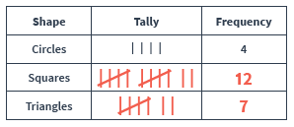
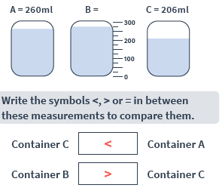
1 | 896
2 | 709
3 | 977
4 | 449
5 | $$\frac{3}{5}$$
1 | 104
2 | 471
3 | 15
4 | 451
5 | $$\frac{7}{9}$$

Slide 12
Summer 2 - Yellow
Week 2
Session 3 – Mixed questions
Option A
Option B
1 | 472 + 100 =
2 | 628 – 100 =
3 | 208 + 90 =
4 | 88 – 30 =
5 | 217 + 600 =
1 | $$\frac{5}{3} −\frac{3}{8}=$$
2 | 183 + 638 =
3 | 701 – 456 =
4 | $$\frac{1}{8}+\frac{5}{8}=$$
5 | $$\frac{3}{4} −\frac{1}{4}=$$

Slide 13
1 | 572
2 | 528
3 | 298
4 | 58
5 | 817
1 | $$\frac{2}{8}$$
2 | 821
3 | 245
4 | $$\frac{6}{8}$$
5 | $$\frac{2}{4} or\frac{1}{3}$$

Slide 14
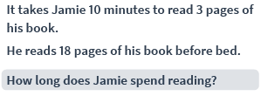
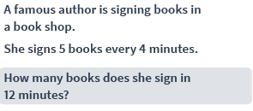
Summer 2 - Yellow
Week 3
Session 1 – Multiplication & Division
Option A
Option B
1 | 27 x 4 =
2 | 85 x 8 =
3 | ÷ 10 = 6
4 | 84 ÷ 4 =
5 | ÷ 2 = 25
1 | 27 ÷ 3 =
2 | 15 x 2 =
3 | 21 ÷ = 7
4 | 35 x 2 =
5 | 30 ÷ 2 =

Slide 15
1 | 9
2 | 30
3 | 3
4 | 70
5 | 15
1 | 108
2 | 680
3 | 60
4 | 21
5 | 50

Slide 16
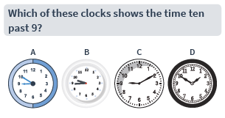
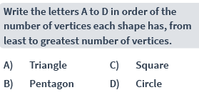
Summer 2 - Yellow
Week 3
Session 2 – Mixed questions
Option A
Option B
1 | 722 – 500 =
2 | 398 + 429 =
3 | 719 + 100 =
4 | 582 – 100 =
5 | 73 + 50 =
1 | 42 + = 72
2 | - 35 = 61
3 | $$\frac{1}{5} of 25=$$
4 | $$\frac{6}{7}−\frac{5}{7}=$$
5 | $$\frac{2}{3} of 30=$$

Slide 17
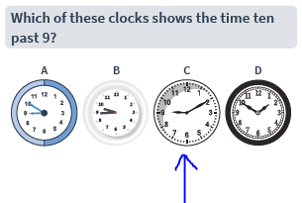
1 | 222
2 | 827
3 | 819
4 | 482
5 | 123
1 | 30
2 | 96
3 | 5
4 | $$\frac{1}{7}$$
5 | 20

Slide 18
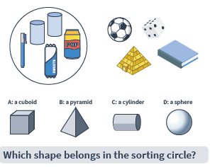
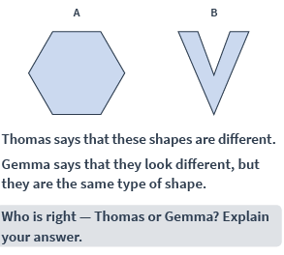
Summer 2 - Yellow
Week 3
Session 3 – Mixed questions
Option A
Option B
1 | 715 – 30 =
2 | 659 + 300 =
3 | 249 – 200 =
4 | 100 – 10 =
5 | 426 + 100 =
1 | 725 – 100 =
2 | 896 + 10 =
3 | 30 + = 150
4 | 305 + 95 =
5 | $$\frac{2}{3} of 36=$$

Slide 19
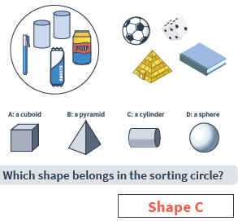
1 | 685
2 | 859
3 | 49
4 | 90
5 | 526
1 | 625
2 | 906
3 | 120
4 | 400
5 | 24

Slide 20
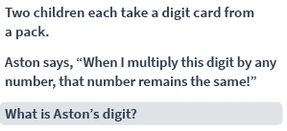
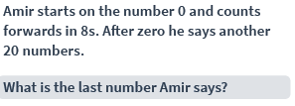
Summer 2 - Yellow
Week 4
Session 1 – Multiplication & Division
Option A
Option B
1 | 90 ÷ 10 =
2 | x 3 = 24
3 | 16 ÷ = 4
4 | 3 x 9 =
5 | 45 ÷ 5 =
1 | 69 x 8 =
2 | 6 x = 48
3 | 12 ÷ = 6
4 | 36 = 9 x
5 | 41 x 2 =

Slide 21
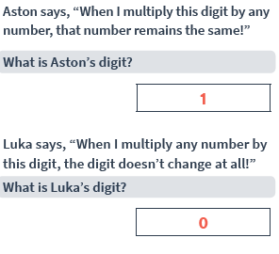
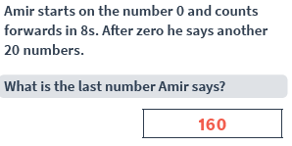
1 | 9
2 | 8
3 | 4
4 | 27
5 | 9
1 | 552
2 | 8
3 | 2
4 | 4
5 | 82

Slide 22
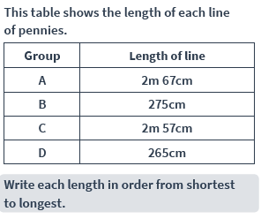
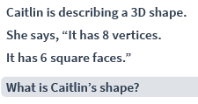
Summer 2 - Yellow
Week 4
Session 2 – Mixed questions
Option A
Option B
1 | 25 + 25 =
2 | 60 – 20 =
3 | 746 + 10 =
4 | $$\frac{2}{3} −\frac{1}{3}=$$
5 | $$\frac{1}{5}of 35=$$
1 | 400 – 100 – 100 =
2 | + 48 = 500
3 | $$\frac{3}{15}+\frac{4}{15}=$$
4 | 652 + 176 =
5 | 396 – 198 =

Slide 23
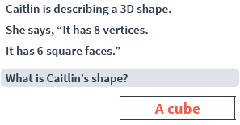
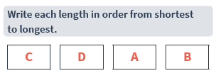
1 | 50
2 | 40
3 | 756
4 | $$\frac{1}{3}$$
5 | 7
1 | 200
2 | 452
3 | $$\frac{7}{15}$$
4 | 828
5 | 198

Slide 24
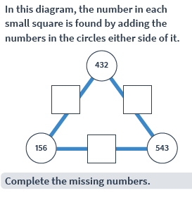
Summer 2 - Yellow
Week 4
Session 3 – Mixed questions
Option A
Option B
1 | $$\frac{4}{7}+\frac{2}{7}=$$
2 | 940 – 70 =
3 | $$\frac{2}{3}of 21=$$
4 | 17 + 100 =
5 | 372 – 102 =
1 | 475 + = 530
2 | 505 – 80 =
3 | 87 – = 68
4 | 481 + 91 =
5 | - 100 = 725
This table shows the favourite sports in Class 3S.
Each pupil had 1 vote.
How many children like sports that are played with a ball?
How many children are in 3S altogether?

Slide 25
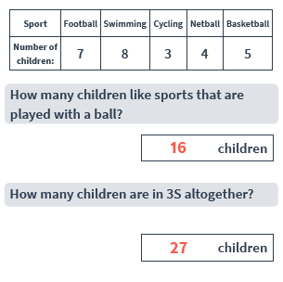
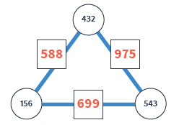
1 | $$\frac{6}{7}$$
2 | 870
3 | 14
4 | 117
5 | 270
1 | 55
2 | 425
3 | 19
4 | 390
5 | 825

Slide 26
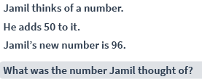
Summer 2 - Yellow
Week 5
Session 1 – Multiplication & Division
Option A
Option B
1 | 50 ÷ 5 =
2 | 64 ÷ 8 =
3 | 12 x 8 =
4 | 70 ÷ 2 =
5 | 6 x = 18
1 | 26 x 3 =
2 | x 3 = 36
3 | 24 ÷ = 3
4 | 15 x 3 =
5 | 24 ÷ 4 =
Liam is making a cake.
He weighs a certain amount of raisins.
How heavy are the raisins?
If Liam makes three cakes, what weight of raisins does he need?
÷

Slide 27
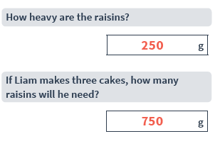
1 | 10
2 | 8
3 | 96
4 | 35
5 | 3
1 | 78
2 | 12
3 | 8
4 | 45
5 | 6

Slide 28
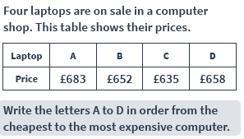
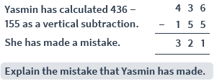
Summer 2 - Yellow
Week 5
Session 2 – Mixed questions
Option A
Option B
1 | 36 + 94 =
2 | $$\frac{8}{10}−\frac{1}{10}=$$
3 | 421 – 84 =
4 | 96 + 9 =
5 | 342 + 60 =
1 | 69 + = 78
2 | 100 + 100 + 50 =
3 | 40 + 95 =
4 | + 96 = 146
5 | 360 – 80 =

Slide 29
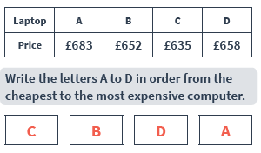
1 | 130
2 | $$\frac{7}{10}$$
3 | 337
4 | 105
5 | 402
1 | 9
2 | 250
3 | 135
4 | 50
5 | 280

Slide 30
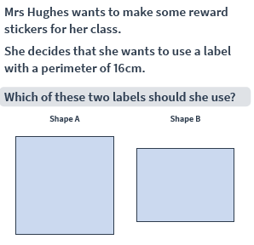
Summer 2 - Yellow
Week 5
Session 3 – Mixed questions
Option A
Option B
1 | 190 – 100 =
2 | 500 – 250 =
3 | 25 + 150 =
4 | 990 - = 950
5 | 400 + = 800
1 | - 200 = 550
2 | 525 + = 600
3 | $$\frac{2}{9}+\frac{4}{9}=$$
4 | $$\frac{1}{3}of 12=$$
5 | 496 + 109 =
These thermometers show the temperature outside in different weather.
What is the difference in temperature between the two days?

Slide 31
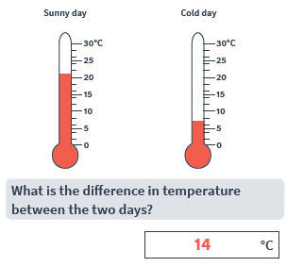
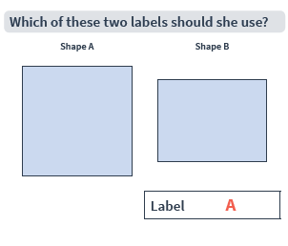
1 | 90
2 | 250
3 | 175
4 | 40
5 | 400
1 | 750
2 | 75
3 | $$\frac{6}{9}$$
4 | 4
5 | 605

Slide 32
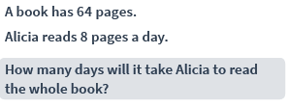
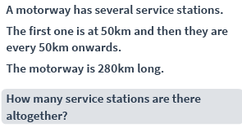
Summer 2 - Yellow
Week 6
Session 1 – Multiplication & Division
Option A
Option B
1 | 12 x 4 =
2 | 50 ÷ 2 =
3 | 38 ÷ 2 =
4 | = 12 x 6
5 | 44 x 3 =
1 | 90 = 10 x
2 | x 8 = 32
3 | 48 ÷ 8 =
4 | 90 ÷ = 45
5 | x 34 = 34
÷

Slide 33
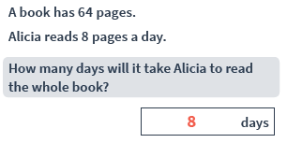
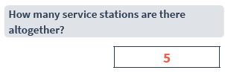
1 | 48
2 | 25
3 | 19
4 | 72
5 | 132
1 | 9
2 | 4
3 | 6
4 | 2
5 | 1

Slide 34
Summer 2 - Yellow
Week 6
Session 2 – Mixed questions
Option A
Option B
1 | 562 – 60 =
2 | $$\frac{1}{5}of 30=$$
3 | 27 + 156 =
4 | 392 – 81 =
5 | $$\frac{1}{4} of 44=$$
1 | 242 – 101 =
2 | 89 + = 179
3 | $$\frac{1}{2}of 70=$$
4 | 600 – 250 =
5 | 543 – 95 =
This pictogram shows the number pf ways children travel to school.
Write the four modes of transport in order from most popular to least popular.
How many children walk to school?

Slide 35
1 | 502
2 | 6
3 | 183
4 | 311
5 | 11
1 | 141
2 | 90
3 | 35
4 | 350
5 | 448

Slide 36
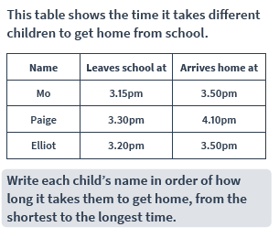
Summer 2 - Yellow
Week 6
Session 3 – Mixed questions
Option A
Option B
1 | 409 + 100 =
2 | 804 – 10 =
3 | 200 + 50 =
4 | 409 – 19 =
5 | $$\frac{4}{5}−\frac{1}{5}=$$
1 | $$\frac{3}{20}−\frac{2}{20}=$$
2 | 800 – 99 =
3 | 350 + = 445
4 | – 49 = 49
5 | 45 + 136 =

Slide 37
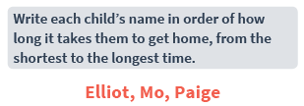
1 | 509
2 | 794
3 | 250
4 | 390
5 | $$\frac{3}{5}$$
1 | $$\frac{1}{20}$$
2 | 701
3 | 95
4 | 98
5 | 181

Slide 38
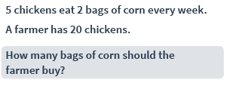
Summer 2 - Yellow
Week 7
Session 1 – Multiplication & Division
Option A
Option B
1 | 54 ÷ 2 =
2 | = 8 x 5
3 | 3 x = 27
4 | 22 x 4 =
5 | 76 ÷ 2 =
1 | 90 ÷ = 9
2 | 14 ÷ 7 =
3 | x 3 = 36
4 | 11 x 7 =
5 | = 4 x 9

Slide 39
1 | 27
2 | 40
3 | 9
4 | 88
5 | 38
1 | 10
2 | 2
3 | 12
4 | 77
5 | 36

Slide 40
Summer 2 - Yellow
Week 7
Session 2 – Mixed questions
Option A
Option B
1 | 900 - = 450
2 | 56 + 184 =
3 | 620 – 100 =
4 | $$\frac{2}{12}+\frac{3}{12}=$$
5 | 80 – 35 =
1 | 100 + 786 =
2 | 842 – 337 =
3 | 32 ÷ = 4
4 | 199 + 275 =
5 | 54 x 4 =

Slide 41
1 | 450
2 | 240
3 | 520
4 | $$\frac{5}{12}$$
5 | 45
1 | 886
2 | 505
3 | 8
4 | 474
5 | 216

Slide 42
Summer 2 - Yellow
Week 7
Session 3 – Mixed questions
Option A
Option B
1 | 420 + 40 =
2 | 35 + = 100
3 | 95 – 16 =
4 | 426 + 140 =
5 | + 10 = 92
1 | $\frac{4}{5}+$ = 1
2 | 450 - = 310 + 100
3 | $$\frac{2}{3} of 24=$$
4 | 482 ml + = 755ml
5 | 3 x 35 = 150 -

Slide 43
1 | 460
2 | 65
3 | 79
4 | 566
5 | 82
1 | $$\frac{1}{5}$$
2 | 40
3 | 16
4 | 273ml
5 | 105
£3 + 50p + 5p + 5p + 1p + 1p + 1p + 1p

