Slide 1
Blue - Summer 1
Autumn 1 (revision of arithmetic skills from year 4)
addition and subtraction / multiplication / decimals
Autumn 2 (revision of arithmetic skills up to and including Autumn 1, year 5)
addition and subtraction / multiplication and division / decimals
Spring 1 (revision of arithmetic skills up to and including Autumn 2, year 5)
addition and subtraction / multiplication and division / decimals
Spring 2 ( revision of arithmetic skills up to and including Spring 1, year 5)
multiplication and division / fractions and decimals / mixed
Summer 1 (mixed arithmetic from year 5)
Multiplication and division / FDP/ mixed
Summer 2 (mixed arithmetic from year 1,2,3,4 & 5)
Mixture

Slide 2
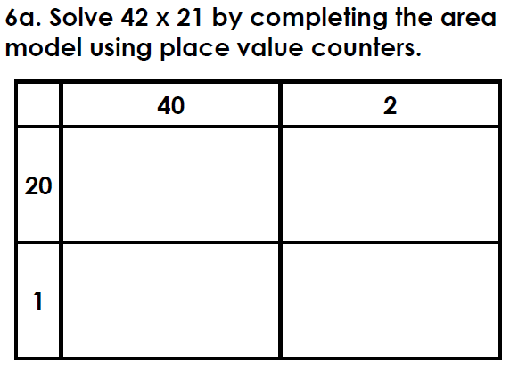
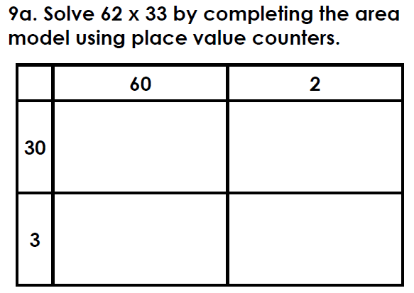
Summer 1 - Blue
Week 1
Session 1
Option A
Option B
1
2 | 42 x 1 =
3 | 123 x 0 =
4 | 8 x = 32
5 | 48 ÷ 4 =
1
2 | 8 x 60 =
3 | 240 ÷ 3 =
4 | 70 x 80 =
5

Slide 3
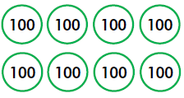
1 | 1047.2
2 | 42
3 | 0
4 | 4
5 | 12
1 | 153,178
2 | 480
3 | 80
4 | 5600
5 | 5452

Slide 4
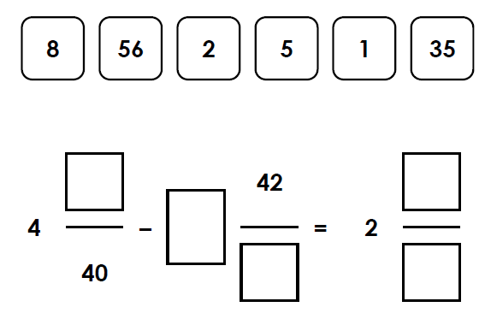
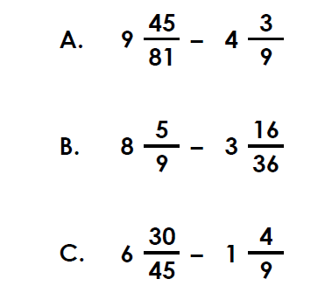
Summer 1 - Blue
Week 1
Session 2
Option A
Option B
1 | $$1\frac{1}{5} x 3=$$
2 | $$\frac{5}{6} −\frac{1}{12}=$$
3 | $$\frac{4}{5} −\frac{1}{5}=$$
4 | $$\frac{1}{6} of 96=$$
5 | 7.5 – 1.9 =
1 | $$\frac{1}{3}+\frac{5}{12}=$$
2 | $$2\frac{4}{5} x 3=$$
3 | $$\frac{11}{9} −\frac{1}{9}=$$
4 | $$\frac{1}{8} x 9=$$
5 | 5.59 x 7 =
Use the digit cards to complete the calculation:
Which is the odd one out?
Explain your reasoning.

Slide 5
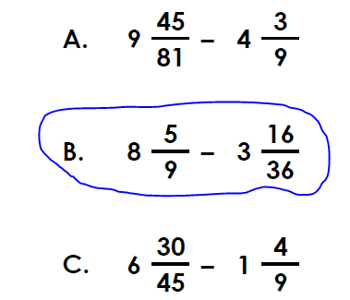
1 | $$3\frac{3}{5}of equivalent e.g.\frac{18}{5}$$
2 | $$\frac{3}{4} or equivalent e.g.\frac{9}{12}$$
3 | $$\frac{3}{5}$$
4 | 16
5 | 5.6
1 | $$\frac{3}{4} or equivalent e.g\frac{9}{12}$$
2 | $$8\frac{2}{5} or equivalent e.g.\frac{42}{5}$$
3 | $$\frac{10}{9} or 1\frac{1}{9}$$
4 | $$1\frac{1}{8} or equivalent e.g.\frac{9}{8}$$
5 | 39.13
B is the odd one out because it equals $5\frac{1}{9}.$
A and C equal $5\frac{2}{9}.$

Slide 6
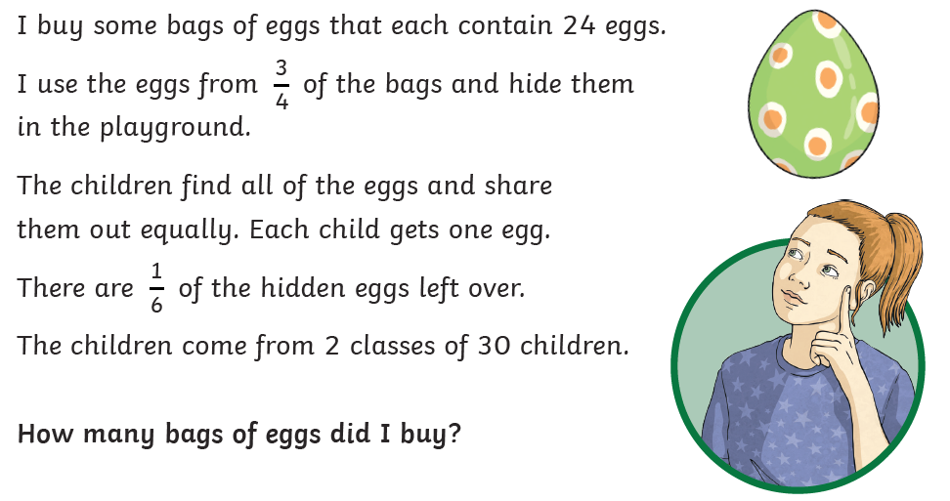
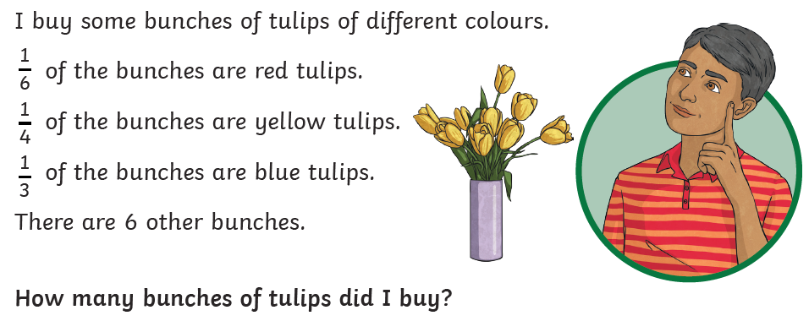
Summer 1 - Blue
Week 1
Session 3
Option A
Option B
1 | 87 x 0 =
2 | 76.4 – 1.95 =
3 | 6050 – 1000 =
4 | 394 + 8 =
5 | 805 ÷ 1 =
1 | $$\frac{8}{9}+\frac{8}{9}=$$
2 | 501,900 – 1000 – 1000 =
3 | 7 x 40 =
4
5 | 210,000 + 450,000

Slide 7
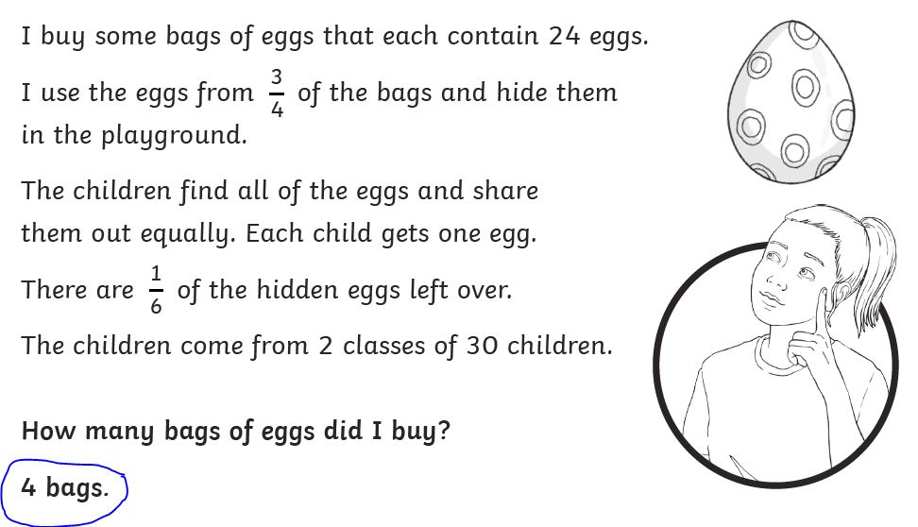
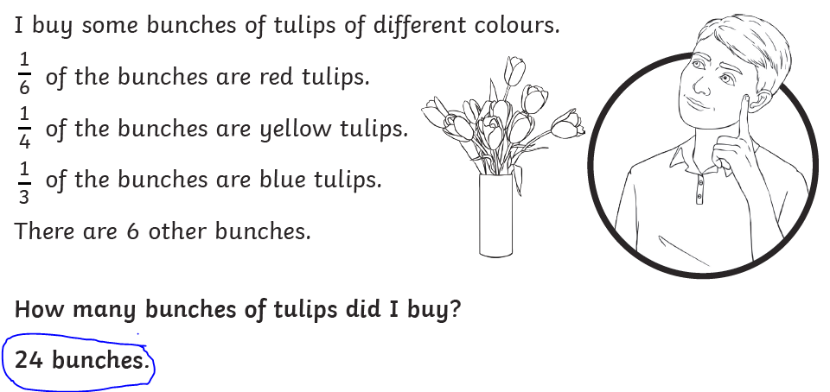
1 | 0
2 | 74.45
3 | 5050
4 | 402
5 | 805
1 | $$1\frac{7}{9} or equivalent e.g.\frac{16}{9}$$
2 | 499,900
3 | 280
4 | 421,580
5 | 870,000

Slide 8
Summer 1 - Blue
Week 2
Session 1
Option A
Option B
1 | 5 x 4 x 2 =
2 | 3² =
3 | 86 ÷ 3 =
4 | 2074 x 8 =
5 | 300 x 60 =
1 | 2167 x 5 =
2 | 4200 ÷ 60 =
3 | 5058 ÷ 6 =
4 | 7² + 2³ =
5 | 1² + 7² - 4² =

Slide 9
1 | 40
2 | 9
3 | 28 remainder 2 or equivalent e.g $28\frac{2}{3}$
4 | 16592
5 | 18000
1 | 10,835
2 | 70
3 | 843
4 | 57
5 | 34

Slide 10
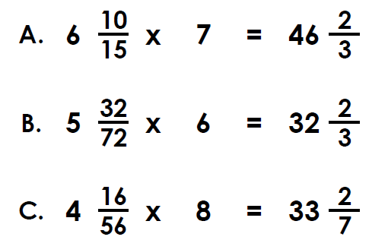
Summer 1 - Blue
Week 2
Session 2
Option A
Option B
1 | 0.68 ÷ 10 =
2 | 0.2 = ?%
3 | 2.814 x 5 =
4 | 0.38 = $\frac{?}{100}$
5 | $$\frac{3}{8} of 120=$$
1 | $$\frac{4}{5} x 3=$$
2 | 57.4 ÷ 7 =
3 | $$\frac{2}{3} −\frac{1}{12}=$$
4 | $$1\frac{1}{3} x 5=$$
5 | 32.04 – 3.735 =
The mixed numbers have been multiplied by the same integer.
What is the missing integer?
Which is the odd one out?
Explain your reasoning.

Slide 11
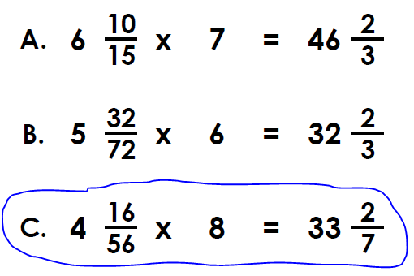
1 | 0.068
2 | 20%
3 | 14.07
4 | $$\frac{38}{100}$$
5 | 45
1 | $$2\frac{2}{5} or equivalent e.g.\frac{12}{5}$$
2 | 8.2
3 | $$\frac{7}{12} or equivalent$$
4 | $$6\frac{2}{3} or equivalent e.g.\frac{20}{3}$$
5 | 28.305
C is the odd one out because it is the only incorrect answer.
The correct answer is $34\frac{2}{7}.$

Slide 12
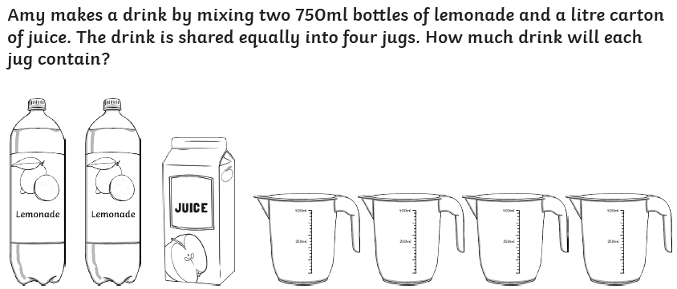
Summer 1 - Blue
Week 2
Session 3
Option A
Option B
1 | 873 + 19 =
2 | 4 x 12 =
3 | 72 ÷ 6 =
4
5
1 | 1392 x 6 =
2 | 30 x 70 =
3 | 88,084 + 8484 =
4 | 9999 + 30 =
5 | $$\frac{1}{8} x 3=$$
Here are two thermometers. One shows the temperature inside, the other shows the temperature outside. What is the temperature on the outside thermometer when the temperature outside is 23⁰C lower than the temperature inside?

Slide 13
1 | 890
2 | 48
3 | 12
4 | 7637
5 | 556
1 | 8352
2 | 2100
3 | 96,568
4 | 10,029
5 | $$\frac{3}{8} or equivalent$$
-5⁰C
625ml or 0.625l

Slide 14
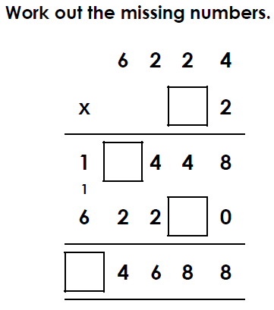
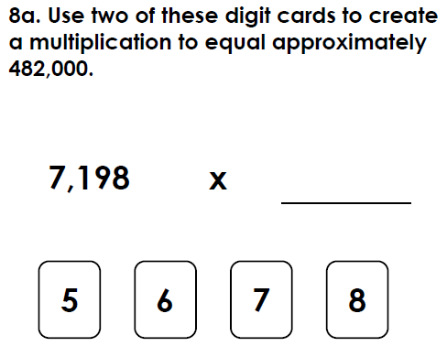
Summer 1 - Blue
Week 3
Session 1
Option A
Option B
1
2 | 8 x 4 x 3 =
3 | 810 ÷ 9 =
4 | 97 ÷ 10 =
5 | 144 ÷ 6 =
1
2 | 785 ÷ 5 =
3 | 180 ÷ 2 = x 6
4 | 654 x 18 =
5 | 168 ÷ 8 =

Slide 15
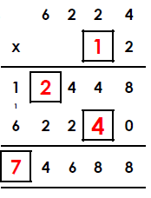
1 | 23066
2 | 96
3 | 90
4 | 9.7
5 | 24
1 | 122,189
2 | 157
3 | 15
4 | 11,772
5 | 21

Slide 16
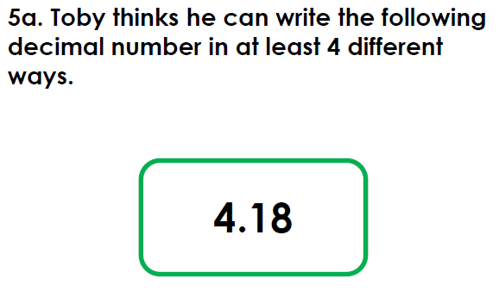
Summer 1 - Blue
Week 3
Session 2
Option A
Option B
1 | 5.8 x 1000 =
2 | 6.9 + 6.15 =
3 | $$\frac{1}{10}+\frac{1}{5}=$$
4 | $$2\frac{5}{8} x 3=$$
5 | 0.8 x 10 =
1 | $$\frac{1}{4}+\frac{5}{6}=$$
2 | $$\frac{6}{8} −\frac{1}{2}=$$
3 | $$\frac{9}{10}+\frac{2}{5}=$$
4 | $$1\frac{3}{5} x 6=$$
5 | $$\frac{2}{3} x 4=$$

Slide 17
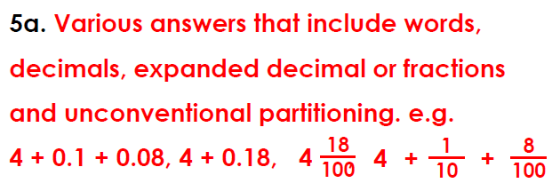
1 | 5800
2 | 13.05
3 | $$\frac{3}{10}$$
4 | $$7\frac{7}{8} or equivalent e.g\frac{63}{8}$$
5 | 8
1 | $$1\frac{1}{12} or equiavlent e.g\frac{13}{12}$$
2 | $\frac{2}{8} or\frac{1}{4}$
3 | $$\frac{13}{10} or 1\frac{3}{10}$$
4 | $$\frac{48}{5} or 9\frac{3}{5}$$
5 | $$\frac{8}{3} or 2\frac{2}{3}$$

Slide 18
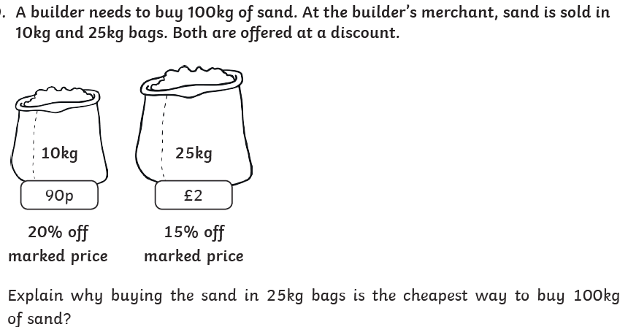
Summer 1 - Blue
Week 3
Session 3
Option A
Option B
1 | $$\frac{5}{9}+\frac{5}{9}=$$
2 | 0.15 = ?%
3 | 2 x 5 x 3 =
4 | 8.6 + 5.6 =
5 | 962 ÷ 5 =
1 | 760,000 – 80,000 =
2 | 360 ÷ 9 =
3 | 4854 ÷ 6 =
4 | 30,001 - = 20,002
5

Slide 19
1 | $$1\frac{1}{9} or equivalent e.g.\frac{10}{9}$$
2 | 15%
3 | 30
4 | 14.2
5 | 192 remainder 2 or equivalent 192.4
1 | 680,000
2 | 40
3 | 809
4 | 9999
5 | 25,874
An answer showing that the cost of the four 25kg bags is £6.80 and the ten 10kg bags is £7.20…
£33

Slide 20
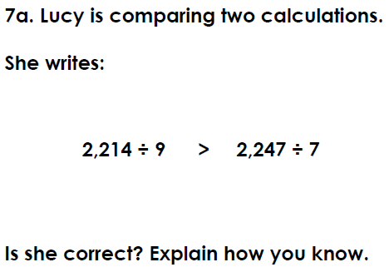
Summer 1 - Blue
Week 4
Session 1
Option A
Option B
1 | 4321 x 32 =
2 | 252 ÷7 =
3 | 612 x 7 =
4 | 2196 x 65 =
5 | 3³ + 10 =
1 | 60 x 5 =
2 | 87 x 8 =
3 | 6³ =
4 | 97 x 7 =
5 | 85 ÷ 100 =

Slide 21
1 | 300
2 | 696
3 | 216
4 | 679
5 | 0.85
1 | 138,272
2 | 36
3 | 4284
4 | 142,740
5 | 37

Slide 22
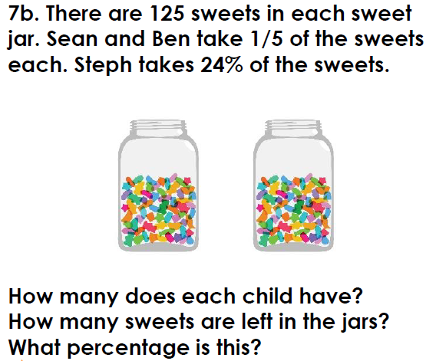
Summer 1 - Blue
Week 4
Session 2
Option A
Option B
1 | 81 – 3.5 =
2 | 12.1 x 100 =
3 | 45.8 + 84 =
4 | $$\frac{3}{4}+\frac{3}{8}=$$
5 | 1.82 x 1000 =
1 | $$\frac{5}{6}+\frac{9}{12}=$$
2 | ¾ - ½ =
3 | 0.09 x 10 =
4 | 40.36 – 10.2 =
5 | $$1\frac{3}{5} x 2=$$

Slide 23
1 | 77.5
2 | 1210
3 | 129.8
4 | $$\frac{9}{8} or 1\frac{1}{8}$$
5 | 1820
1 | $$\frac{19}{12} or 1\frac{7}{12}$$
2 | ¼
3 | 0.9
4 | 30.16
5 | $$\frac{16}{5} or 3\frac{1}{5}$$

Slide 24
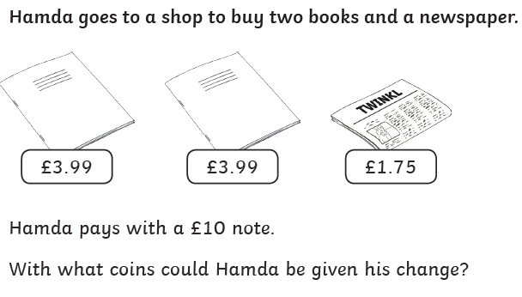
Summer 1 - Blue
Week 4
Session 3
Option A
Option B
1 | 21125 – 9608 =
2 | $$\frac{6}{7} of 63=$$
3 | 75.3 ÷ 10 =
4 | 36.21 x 100 =
5 | 50 x 40 =
1 | 7² + 1³ =
2
3 | 789,821 – 39,927 =
4 | $$\frac{4}{5}x 8=$$
5

Slide 25
1 | 11517
2 | 54
3 | 7.53
4 | 3621
5 | 2000
1 | 50
2 | 33.3
3 | 749,894
4 | $$6\frac{2}{5} or equivalent e.g.\frac{32}{5}$$
5 | 5152
91 children

Slide 26
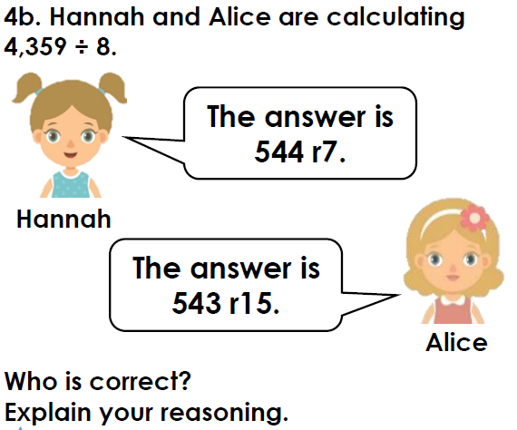
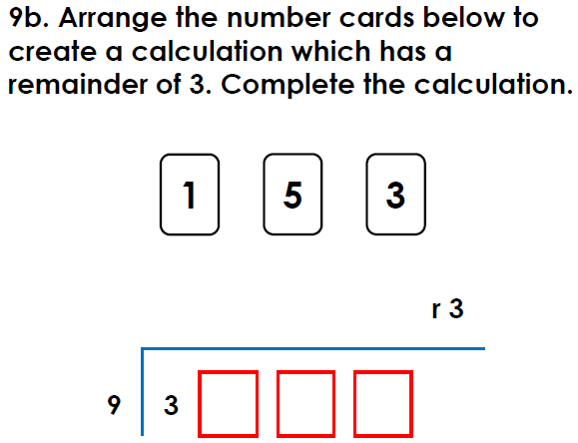
Summer 1 - Blue
Week 5
Session 1
Option A
Option B
1 | 563 x 34 =
2 | 15496 ÷ 1000 =
3 | 814 x 63 =
4 | 74 ÷ 2 =
5 | 23 x 9 =
1 | 7 x 5 x 3 =
2 | 643 x 57 =
3 | 192 ÷6 =
4 | 8432 x 32 =
5 | 6² - 16 =

Slide 27
1 | 19142
2 | 15.496
3 | 51282
4 | 37
5 | 207
1 | 105
2 | 36,651
3 | 32
4 | 269,824
5 | 20

Slide 28
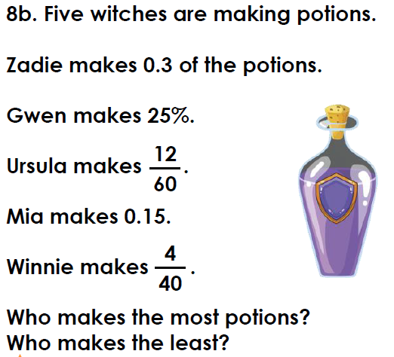
Summer 1 - Blue
Week 5
Session 2
Option A
Option B
1 | $$\frac{2}{4}+\frac{5}{12}=$$
2 | $$\frac{2}{7}+\frac{9}{14}=$$
3 | 9.7 – 3.4 =
4 | 18.3 – 6 =
5 | 4.2 + 3.6 =
1 | $$\frac{2}{7} x 5=$$
2 | $$\frac{4}{5} x 3=$$
3 | 3.8 + 7.2 =
4 | = 9.7 – 6.8
5 | $$\frac{3}{5}+\frac{2}{15}=$$

Slide 29
1 | $$\frac{11}{12}$$
2 | $$\frac{13}{14}$$
3 | 6.3
4 | 12.3
5 | 7.8
1 | $$\frac{10}{7} or 1\frac{3}{7}$$
2 | $$\frac{12}{5} or 2\frac{2}{5}$$
3 | 11
4 | 2.9
5 | $$\frac{11}{15}$$

Slide 30
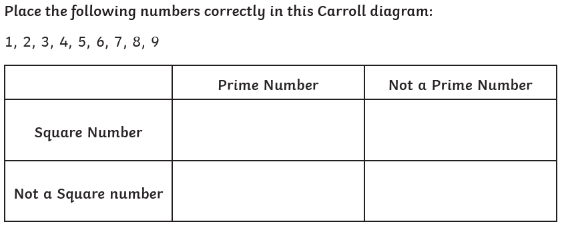
Summer 1 - Blue
Week 5
Session 3
Option A
Option B
1
2 | $$\frac{1}{4} of 308=$$
3 | $$0.6= \frac{?}{10}$$
4
5 | 3³ + 5² =
1 | $$\frac{2}{3} −\frac{2}{9}=$$
2 | 10.5 ÷ 7 =
3 | 1500 ÷ 50 =
4 | 1² + 8² - 3² =
5 | 45.00 – 3.542 =

Slide 31
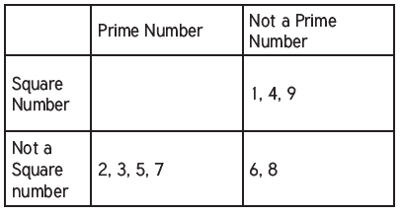
1 | 7581
2 | 77
3 | $$\frac{6}{10}$$
4 | 2604
5 | 52
1 | $$\frac{4}{9} or equivalent$$
2 | 1.5
3 | 30
4 | 56
5 | 41.458

